Slide 1


Grocery Store Management
Presented By:
Jidnyasa Thakre
K.Jahnavi
S.Shruthi

Slide 2
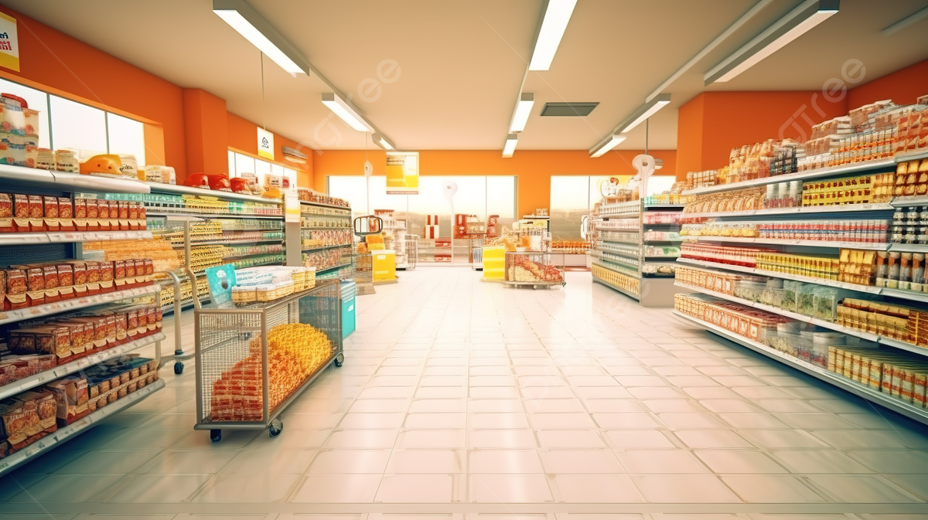
Grocery Store Management

Slide 3
Agenda :
Objectives
ER Diagram
Tables
Key analysis questions
SQL query results
Final business insights
Recommendations
Conclusion

Slide 4
OBJECTIVES:
To design a centralized SQL database for storing and managing all grocery store information.
To simplify customer, supplier, employee, and product management.
To enable easy tracking of orders, sales, and transactions.
To provide accurate inventory management and avoid stock-out/overstock issues.
To improve data accuracy, reliability, and security compared to manual record-keeping.
To generate useful reports and insights for better business decision-making.
To save time, reduce manual errors, and ensure efficient store operations.

Slide 5
INTRODUCTION :
Grocery Store Management System (GSM) is a database-driven application designed to handle the daily operations of a grocery business.
It allows easy management of customers, suppliers, employees, products, categories, and orders.
Using SQL as the backbone, the system ensures all information is stored in a structured and secure way.
GSM helps in tracking inventory levels, managing supplier details, and monitoring customer purchases.
Store managers can quickly generate reports like sales history, most purchased products, and supplier performance.
Overall, GSM improves business decision-making, customer satisfaction, and operational efficiency.

Slide 6
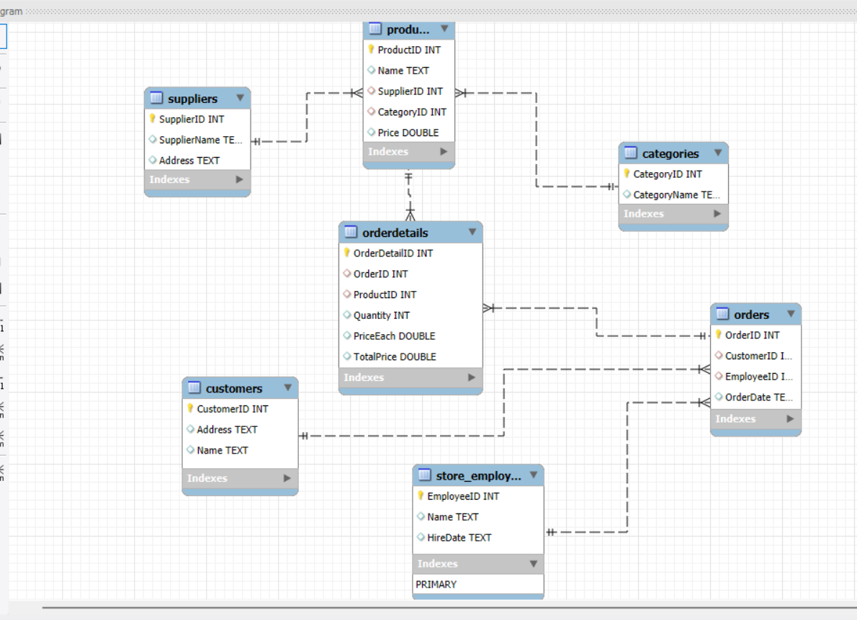
ER Diagram :

Slide 7
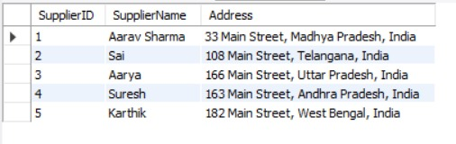
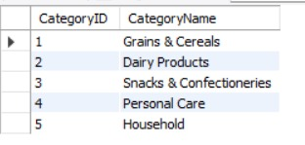
Supplier:
Category :

Slide 8
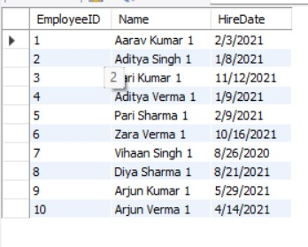
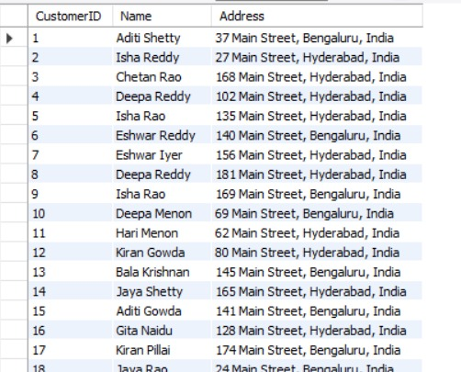
Store_employees:
Customers:

Slide 9
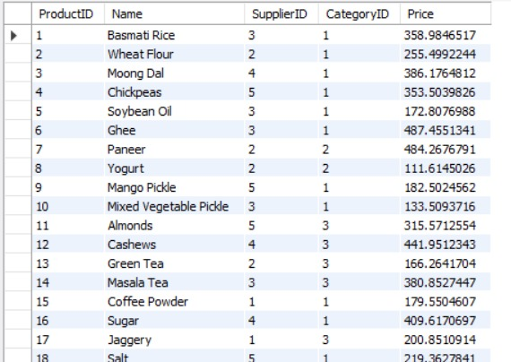
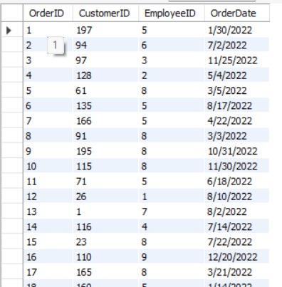
products:
Orders:

Slide 10
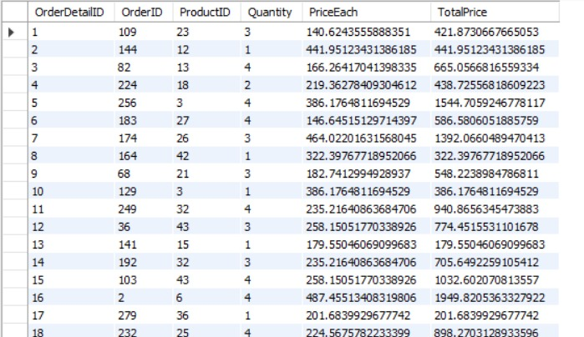
Orderdetails:

Slide 11

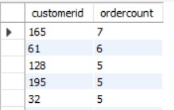
1. CUSTOMER INSIGHTS
-- How many unique customers have placed orders?
SELECT COUNT(DISTINCT cust_ID) AS UniqueCustomers
FROM Orders;
-- Which customers have placed the highest number of orders?
SELECT Cust_ID, COUNT(Ord_ID) AS OrderCount
FROM Orders
GROUP BY Cust_ID
ORDER BY OrderCount DESC;

Slide 12
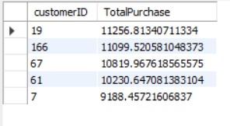
-- 4.Who are the top 5 customers by total purchase amount?
SELECT o.customerID,
SUM(od.PriceEach * od.Quantity) AS TotalPurchase
FROM Orders o
JOIN OrderDetails od ON o.OrderID = od.OrderID
GROUP BY o.customerID
ORDER BY TotalPurchase DESC
LIMIT 5;

Slide 13
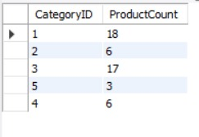
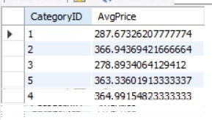
2. Product Performance:
-- 1. How many products exist in each category?
SELECT CategoryID, COUNT(ProductID) AS ProductCount
FROM Products
GROUP BY CategoryID;
-- 2. What is the average price of products by category?
SELECT CategoryID, AVG(Price) AS AvgPrice
FROM Products
GROUP BY CategoryID;

Slide 14
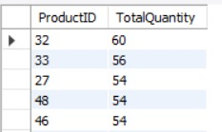
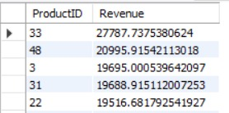
-- 3. Which products have the highest total sales volume (by quantity)?
SELECT ProductID, SUM(Quantity) AS TotalQuantity
FROM OrderDetails
GROUP BY ProductID
ORDER BY TotalQuantity DESC;
-- 4. What is the total revenue generated by each product?
SELECT ProductID, SUM(PriceEach * Quantity) AS Revenue
FROM OrderDetails
GROUP BY ProductID
ORDER BY Revenue DESC;

Slide 15


3. SALES AND ORDER TRENDS:
-- 1. How many orders have been placed in total?
SELECT COUNT(OrderID) AS TotalOrders
FROM Orders;
-- 2. What is the average value per order?
SELECT AVG(OrderID) AS Avg_Value_per_Order
FROM (
SELECT o.OrderID, SUM(od.PriceEach * od.Quantity) AS OrderTotal
FROM Orders o
JOIN OrderDetails od ON o.OrderID = od.OrderID
GROUP BY o.OrderID
) t;

Slide 16
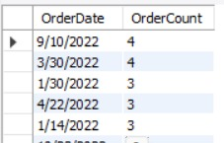

-- 3. On which dates were the most orders placed?
SELECT OrderDate, COUNT(OrderID) AS OrderCount
FROM Orders
GROUP BY OrderDate
ORDER BY OrderCount DESC;
-- 4. What are the monthly trends in order volume and revenue?
SELECT YEAR(OrderDate) AS Year, MONTH(OrderDate) AS Month,
COUNT(o.OrderID) AS OrderCount,
SUM(od.PriceEach * od.Quantity) AS Revenue
FROM Orders o
JOIN OrderDetails od ON o.OrderID = od.OrderID
GROUP BY YEAR(OrderDate), MONTH(OrderDate)
ORDER BY Year, Month;

Slide 17

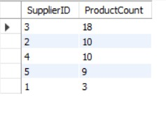
4. SUPPLIER CONTRIBUTION:
-- 1. How many suppliers are there in the database?
SELECT COUNT(DISTINCT SupplierID) AS SupplierCount
FROM Suppliers;
-- 2. Which supplier provides the most products?
SELECT SupplierID, COUNT(ProductID) AS ProductCount
FROM Products
GROUP BY SupplierID
ORDER BY ProductCount DESC;

Slide 18
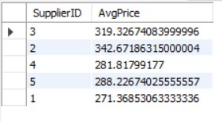
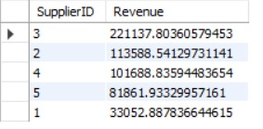
-- 3.What is the average price of products from each supplier?
SELECT SupplierID, AVG(Price) AS AvgPrice
FROM Products
GROUP BY SupplierID;
-- 4. Which suppliers contribute the most to total product sales (by revenue)?
SELECT p.SupplierID, SUM(od.PriceEach * od.Quantity) AS Revenue
FROM OrderDetails od
JOIN Products p ON od.ProductID = p.ProductID
GROUP BY p.SupplierID
ORDER BY Revenue DESC;

Slide 19

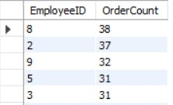
5. EMPLOYEE PERFORMANCE:
-- 1. How many employees have processed orders?
SELECT COUNT(DISTINCT EmployeeID) AS EmployeeCount
FROM Orders;
-- 2.Which employees have handled the most orders?
SELECT EmployeeID, COUNT(OrderID) AS OrderCount
FROM Orders
GROUP BY EmployeeID
ORDER BY OrderCount DESC;

Slide 20
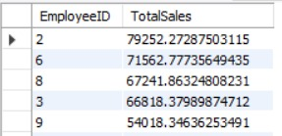
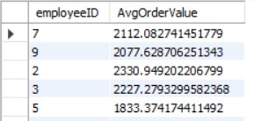
-- 3. What is the total sales value processed by each employee?
SELECT o.EmployeeID, SUM(od.PriceEach * od.Quantity) AS TotalSales
FROM Orders o
JOIN OrderDetails od ON o.OrderID = od.OrderID
GROUP BY o.EmployeeID
ORDER BY TotalSales DESC;
-- 4. What is the average order value handled per employee?
SELECT employeeID, AVG(OrderValue) AS AvgOrderValue
FROM (
SELECT o.OrderID, o.employeeID, SUM(od.PriceEach * od.Quantity) AS OrderValue
FROM Orders o
JOIN OrderDetails od ON o.OrderID = od.OrderID
GROUP BY o.OrderID, o.employeeID
) t
GROUP BY employeeID;

Slide 21
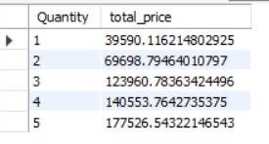
6. ORDER DETAILS DEEP DIVE:
-- 1. What is the relationship between quantity ordered and total price?
SELECT
od.Quantity,
SUM(od.Quantity * od.PriceEach) AS total_price
FROM
orderdetails od
GROUP BY
od.Quantity
ORDER BY
od.Quantity;

Slide 22
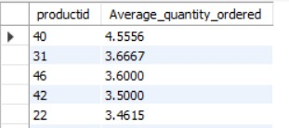
-- 2. What is the average quantity ordered per product?
SELECT
productid,
AVG(quantity) AS Average_quantity_ordered
FROM
orderdetails
GROUP BY
productid
ORDER BY
Average_quantity_ordered DESC;

Slide 23
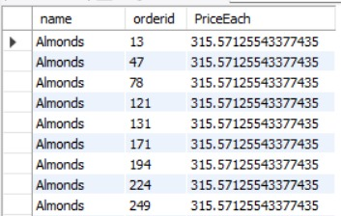
-- 3.How does the unit price vary across products and orders?
SELECT
p.name,
od.orderid,
od.PriceEach
FROM
orderdetails od
JOIN
products p ON od.productid = p.productid
ORDER BY
p.name,
od.orderid;

Slide 24
INSIGHTS
Customer Insights
Product Performance
Sales & Revenue Trends
Employee Performance
Suppliers Contribution
Order Details

Slide 25
RECOMMENDATIONS
Enhance Customer Loyalty:
Launch loyalty programs for top customers. Offer personalized discounts based on buying history.
Boost Product Sales:
Increase stock and promotion for best-selling items. Introduce bundle offers for slow-moving products.
Optimize Inventory:
Maintain safety stock for high-demand products. Reduce overstock of low-performing items.
Improve Supplier Relationships:
Prioritize reliable suppliers with consistent delivery. Negotiate better terms with high-performing suppliers.
Data-Driven Decision Making:
Continue using SQL reports for weekly/monthly insights. Integrate sales trends into marketing and stocking strategies.

Slide 26
⭐ Key Insights of project :
Top customers drive most of the revenue.
Best-selling products dominate sales; some items need better promotion.
Orders peak on specific dates/months, guiding stock planning.
A few suppliers provide most products and revenue.
Certain employees handle majority of orders and sales.
Higher quantities directly boost total order value.

Slide 27
Conclusion:
The Grocery Store Management System organizes and analyzes store data using SQL, enabling quick and accurate reporting.
It provides actionable insights to boost sales, manage inventory efficiently, and improve overall business decisions

Slide 28

THANK YOU

